Slide 1








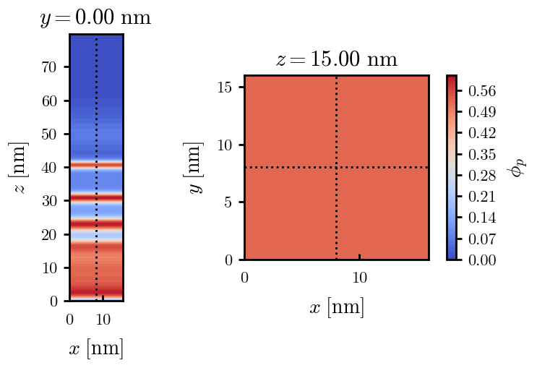







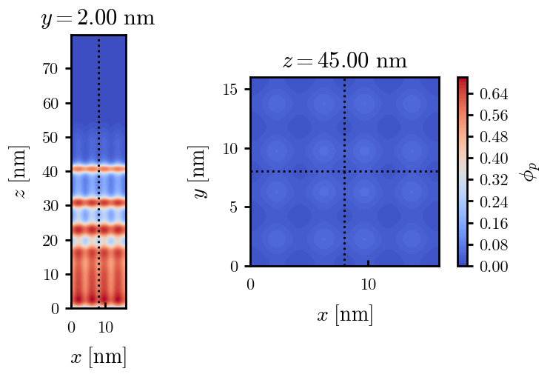
X200 x170 x130 x120 x100
PROG
PROG
PROG
PROG
PROG
PROG
PROG
PROG

Slide 2





a040x100 relaxation

Slide 3






































a040x100 seed
old
old

Slide 4

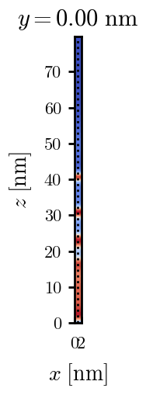
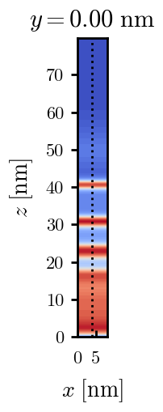
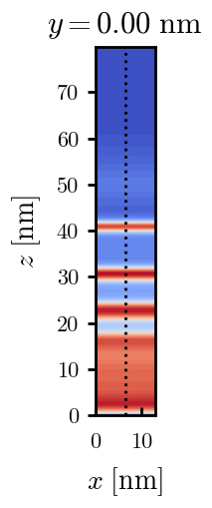
a040x120 relaxation

Slide 5











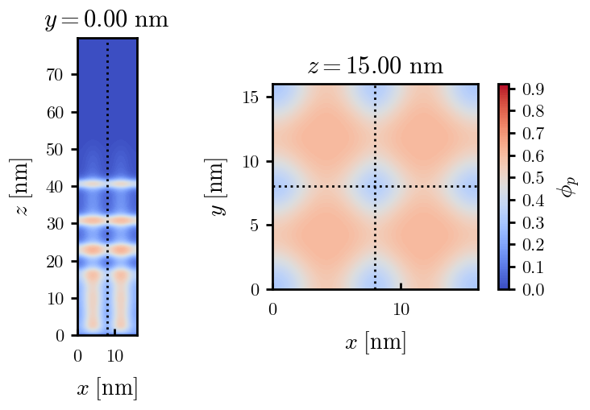

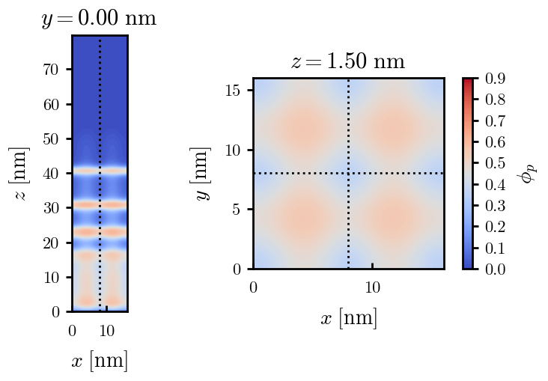







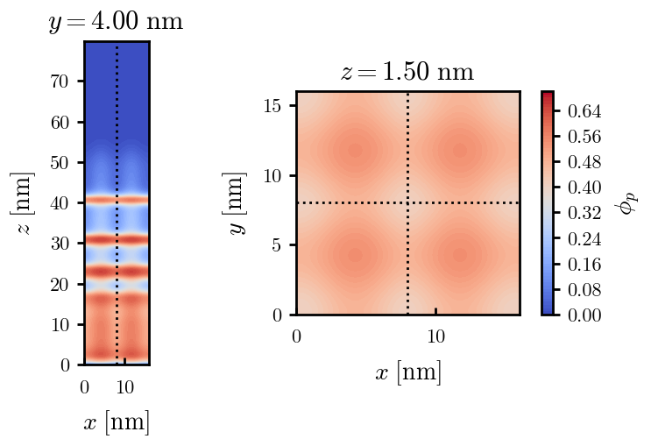


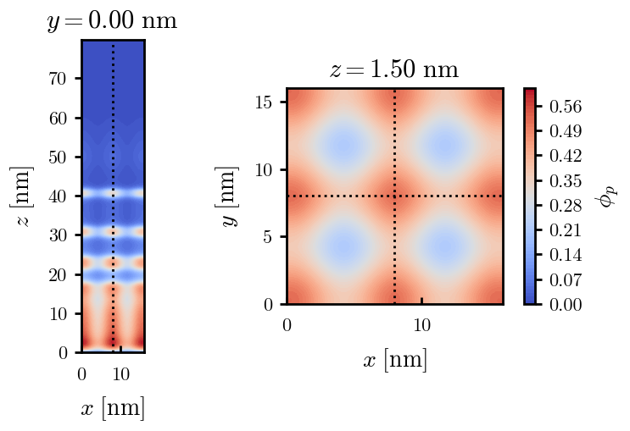

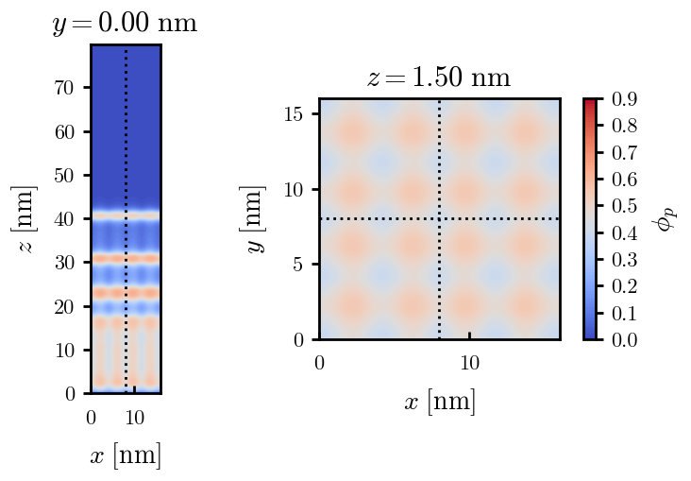

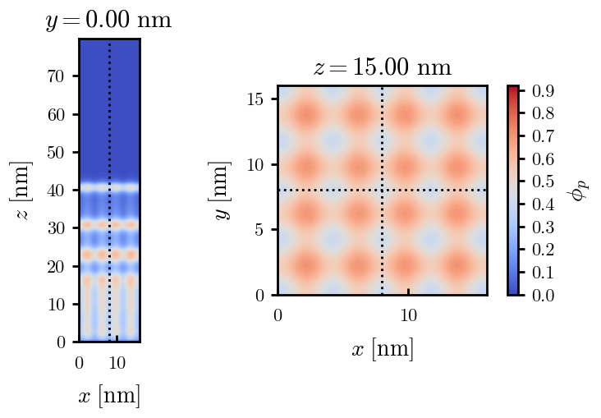

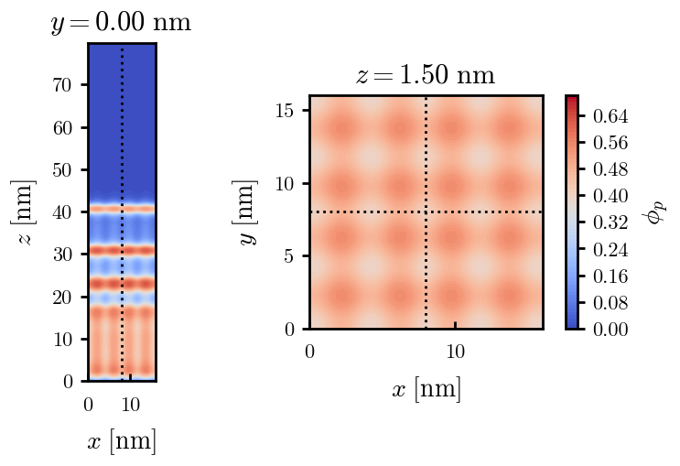





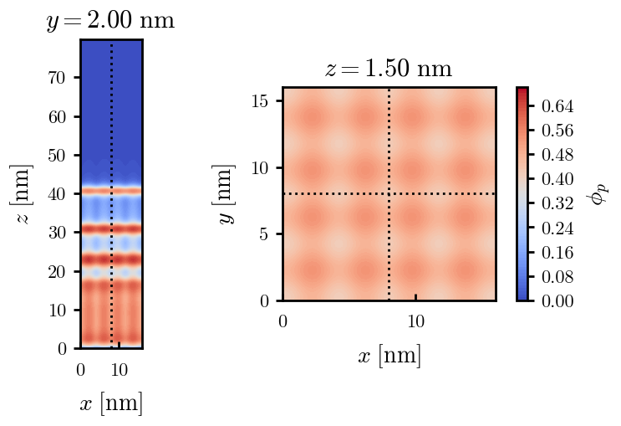

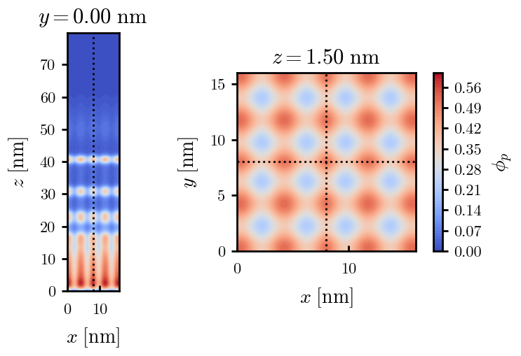


a040x120 seed
halted
halted

Slide 6






a040x130 relaxation

Slide 7
a040x130 seed

Slide 8

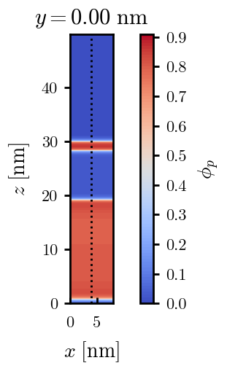
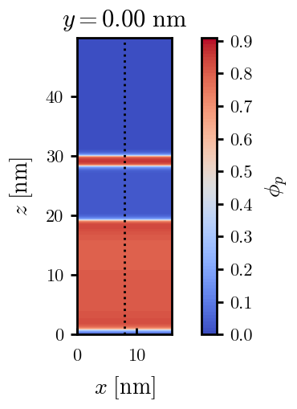
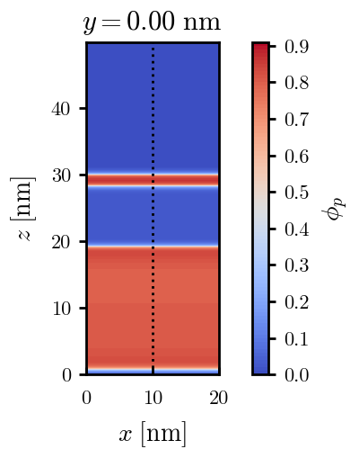
a040x170 relaxation

Slide 9
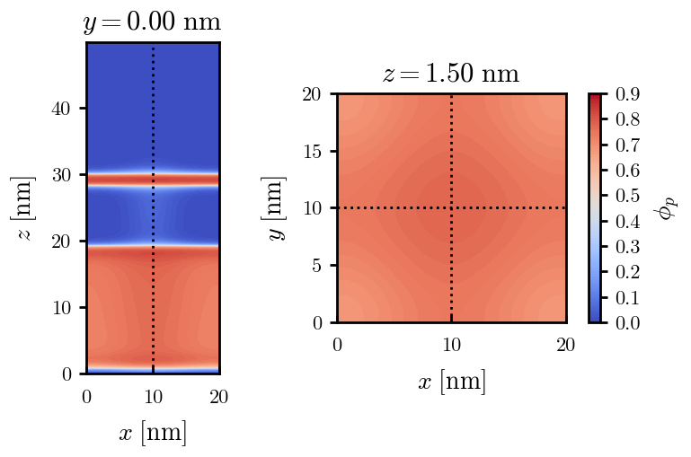







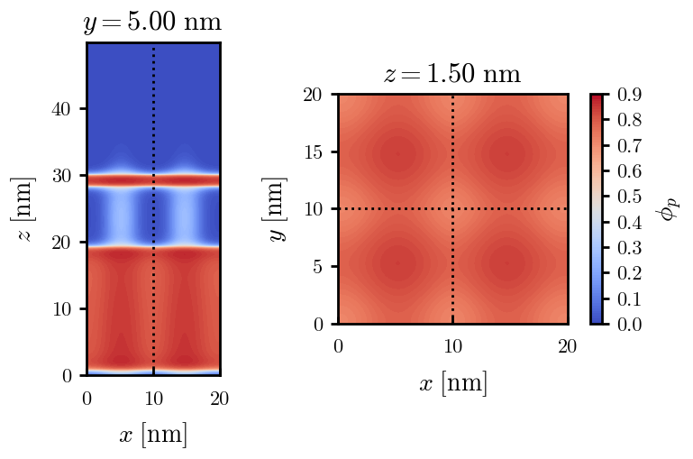


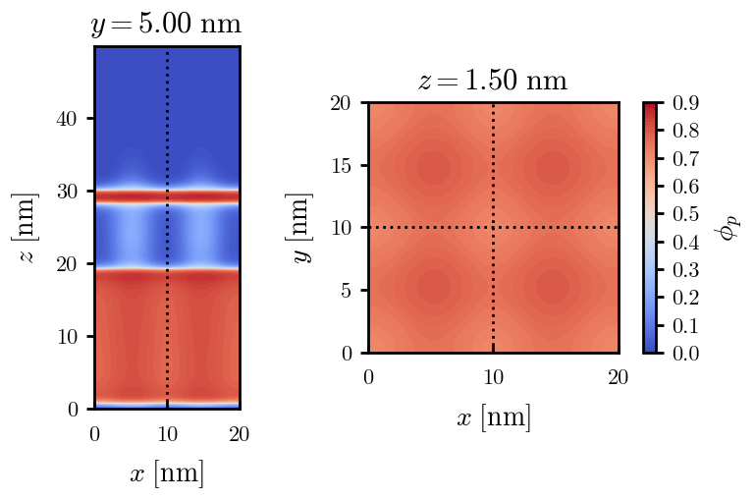


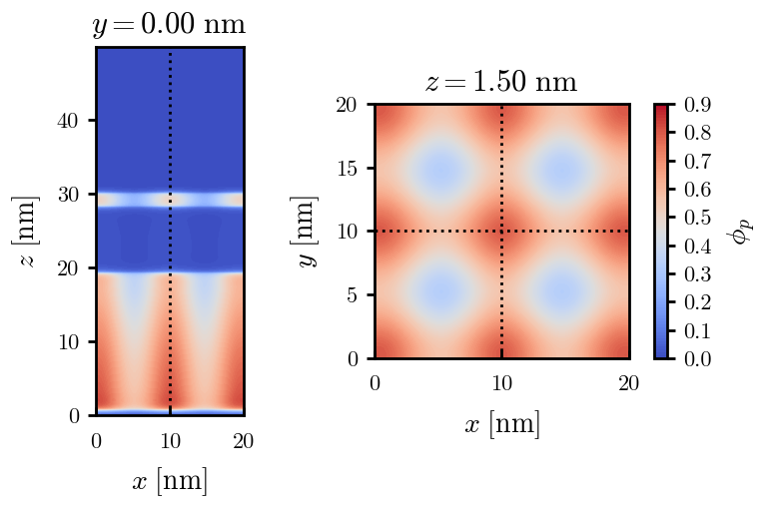
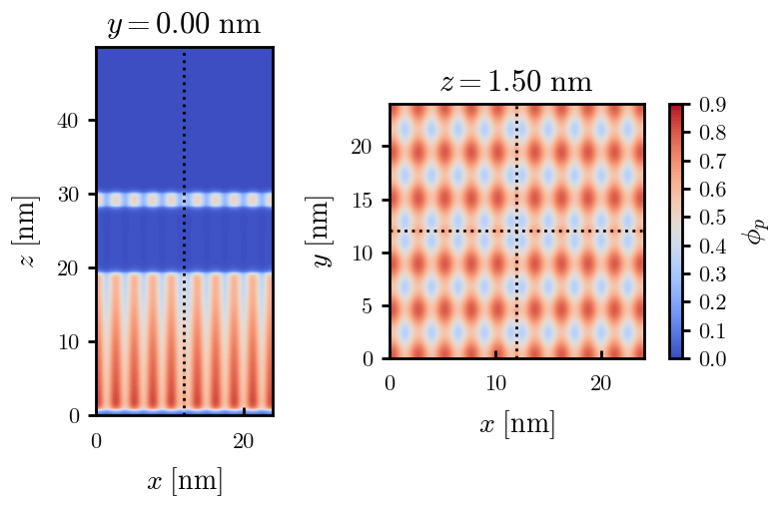









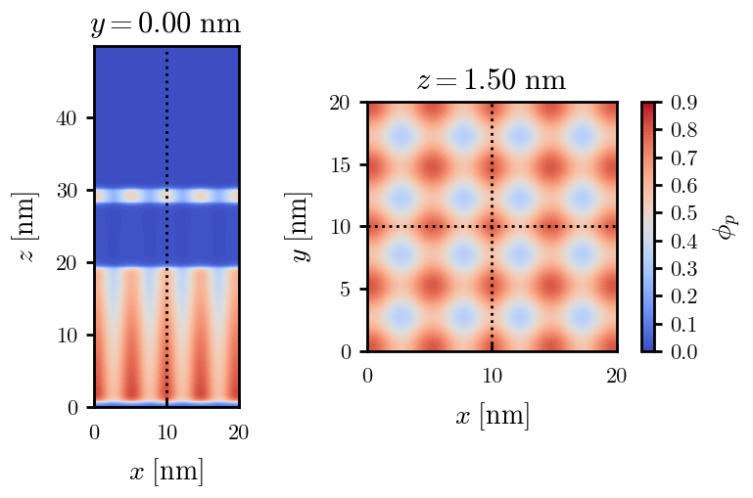


a040x170 seed
halted
old
old

Slide 10








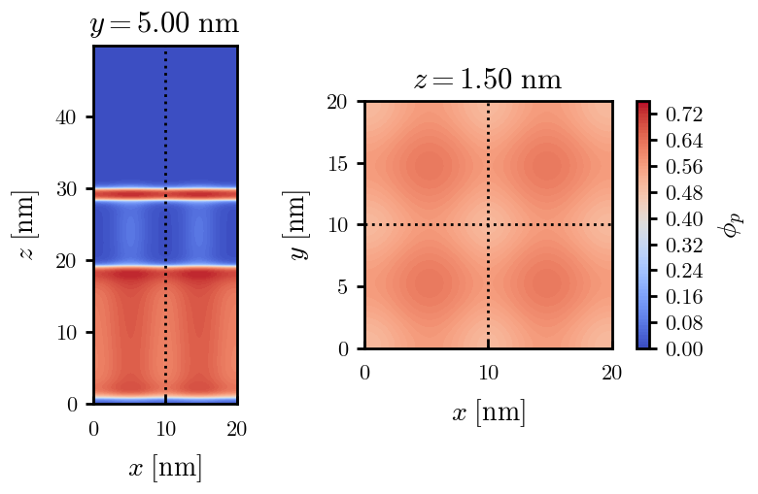












a040x170s015 seed
halted
halted
halted

Slide 11
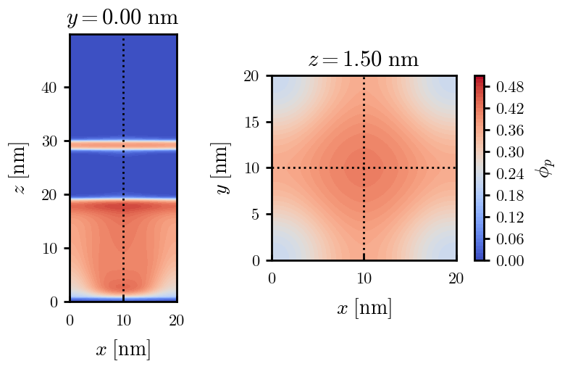
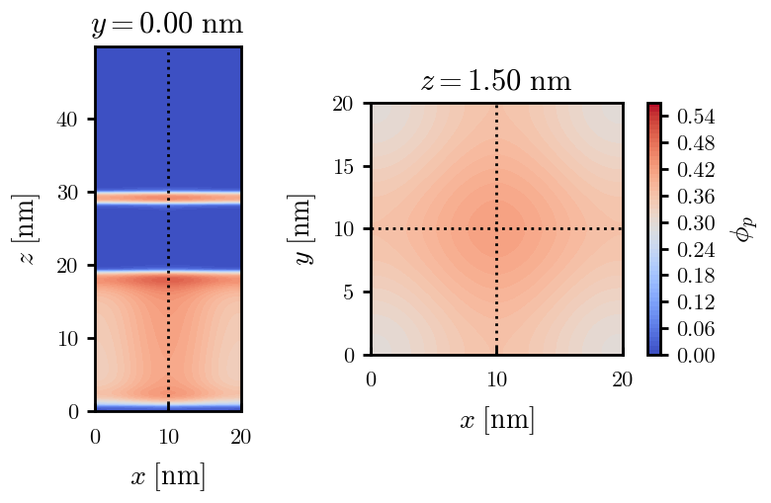
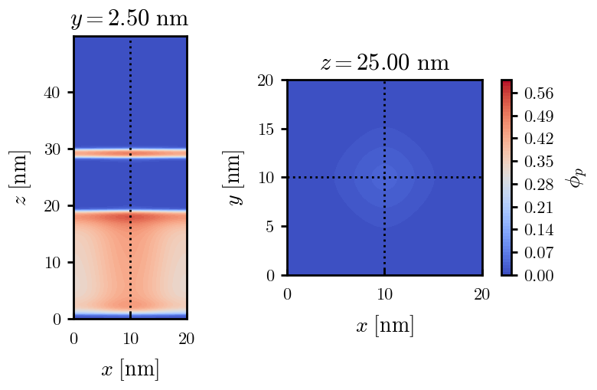
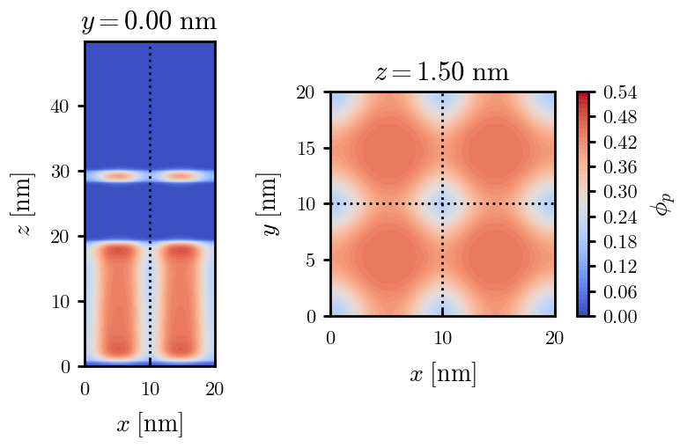
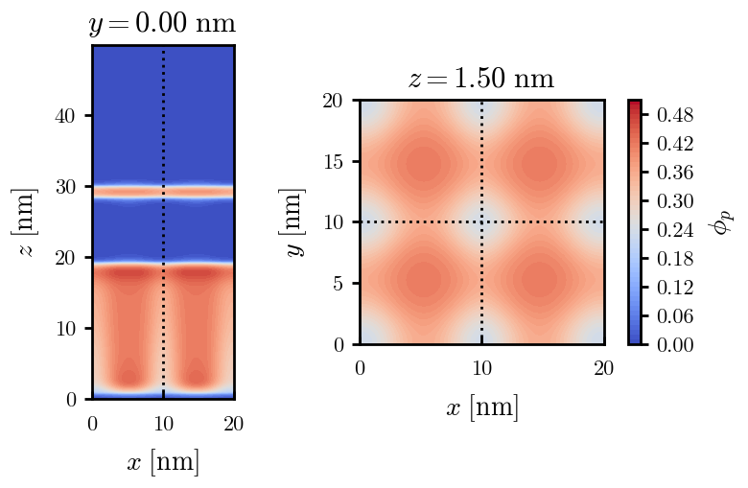
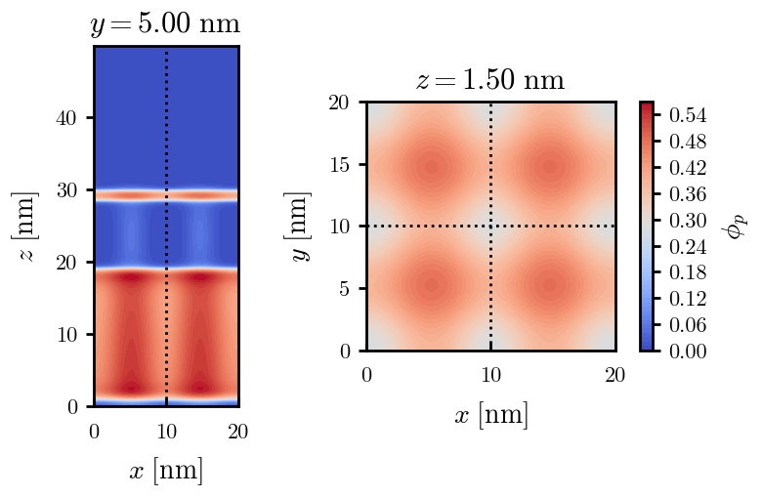
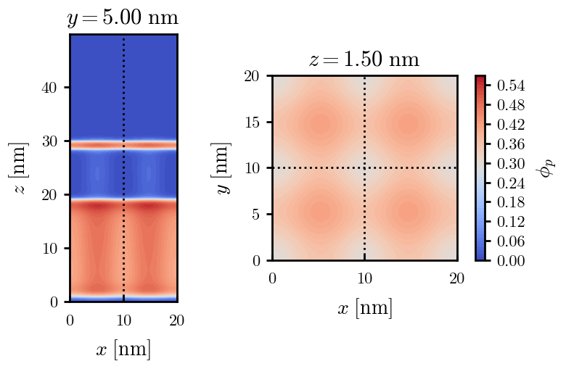
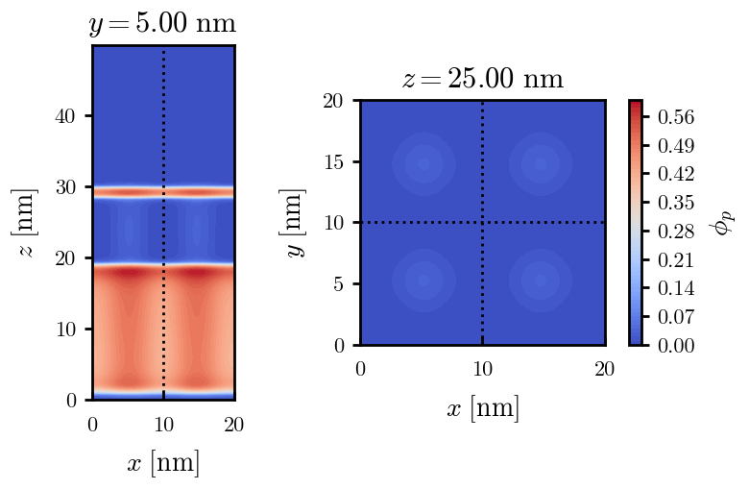


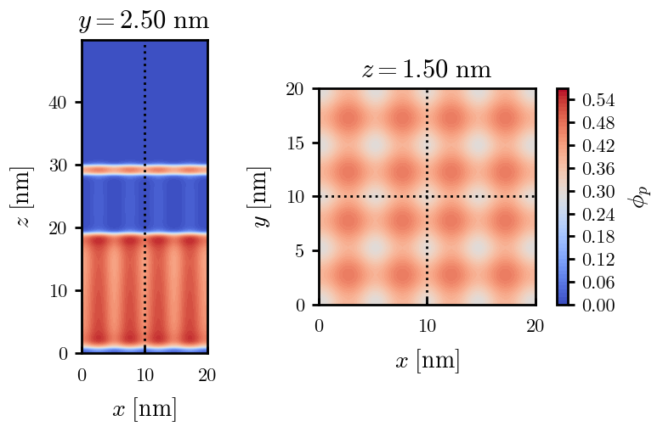


a040x170s010 seed

Slide 12
[TODO, check lxy needed] a040x170s005 seed

Slide 13







a040x200 relaxation

Slide 14










a040x200 seed
Note: not completely converged but stopped for resources

Slide 15





Zhulina JCP 1998
a = 0.01
0.1 mM
1 mM
May need to init using sine
10 mM
25 mM
Zhulina NVT; current GCE runs at Lz = 20

Slide 16

Carrillo Langmuir 2009

Slide 17

Parallelization

Slide 18
Equations
Quenched average, np, A --> \inf ; np/A → \sigma
Discrete Gaussian chain

Slide 19




Scaling (Alexander—de Gennes brush)
V = 4.2; H = 27.5 – 30.5
V = 2; H = 39 – 45.5

Slide 20






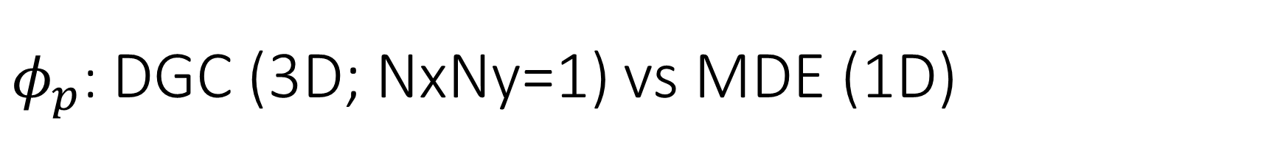
$φ_{p}$: DGC (3D; NxNy=1) vs MDE (1D)
Ns/sigs: dz = 0.10, Ngz_2 = 4$σ$; Chis/bs: dz = 0.25, Ngz_2 = 3.5$σ$

Slide 21


Numericals
Ys
Possibly do Ngz for multiple dzs

Slide 22








3D
Lxy = 1
Lxy = 10
Lxy = 5
Lxy = 15
y-z heatmaps for $φ_{p}$ at constant x

Slide 23





z-FFT vs z-FD (MDE) – REDFT01 xy(z)
Lx = 5, Ly = 5, Lz = 50. s = 0.02. x = 0.75. a = 0.00, N = 50
3D vs 1D (dashed): dz = 0.5, ds = 0.20; dz_1D = 0.113, ds_1D = 0.083
FFT (xyz)
FFT (yz vs pha)
FD (xyz)
FD (yz vs pha)
Diff btw 1D/3D should just be dz, ds, etc.

Slide 24
Specifying Grafted Points

Slide 25
Strategy
2D binary array for surface sites of homogeneously grafted polymer given grafting density, simulation box size, and discretization (and assuming dx = dy)
Fullspace must be periodic on x0 = xL, y0 = yL
Halfspace must be even on xL/2 and yL/2 (overlap of boundary following REDFT00) and periodic on x0 = xL, y0 = yL.
Homogeneous spacing as determined by regular hexagon, where grafting point at centroid of hexagon
In case there are edge effects, try shifting the centroids away from the boundaries of the xy-plane (only did for fullspace)
Make sure no edge effects by comparing results of full FFT with cos FFT

Slide 26
Test conditions
Sigma = 0.05 c/nm2
Lx = 15 nm
Ly = 15 nm
dx = 0.4 nm
Cast in terms of dx (for rounding and PBC for grafting points):
Sigma = 0.0668 c/nm2
Lx = 14.80 nm
Ly = 11.20 nm
(Sigma error decrease with dx)

Slide 27

Padded PBC (Full FFT)
Hexagons drawn for illustration of hexagon approach

Slide 28

Unpadded PBC (Full/Cos FFT)

Slide 29






Other conditions (full and half results overlapped to show match)
s = 0.0241 (20.28%; dx=0.4), Lx, Ly = 12.40, 20.80
s = 0.0208 (4.08%; dx=0.1), Lx, Ly = 12.90, 22.30
s = 0.1332 (11%; dx=0.1), Lx, Ly = 20.50, 20.40

Slide 30


